Slide 1
Operating Systems and Architectures CSCM98 Part 4 Deadlocks and Resource Management
Dr. Benjamin Mora
1
Swansea University
Benjamin Mora

Slide 2
Content
Problem.
Deadlock conditions and modelling.
Dealing with deadlocks
Detection and Recovery.
Preventing deadlocks
Ensured before hand.
Avoiding deadlocks
Dynamic handling.
Access to Resources: Banker’s algorithm.
Starvation
2
Swansea University
Benjamin Mora

Slide 3
Problem
Resources are shared by processes, but cannot be accessed at the same time
Access to resources is usually asynchronous and random.
Example:
Process 1
Process 2
Wait for Resource 1 availability
Wait for Resource 2 availability
Wait for Resource 2 availability
Wait for Resource 1 availability
Use Resources 1 and 2
Use Resources 1 and 2
Release Resources 1 and 2
Release Resources 1 and 2
3
Swansea University
Benjamin Mora
Notes:
A deadlock appears here after

Slide 4
Deadlock Conditions & Modeling
Tanenbaum Definition:
A set of processes is deadlocked if each process in the set is waiting for an event (or resource…) that only another process in the set can cause (release…).
4
University of Wales Swansea
Benjamin Mora

Slide 5
Deadlock : Resources
Type of resources:
Reusable :
One at a time.
Not depleted after use.
Semaphores, CPUs, Critical Sections,…
Consumable :
Can be created and destroyed (after use).
Unlimited.
Example : Signals, information, …
5
Swansea University
Benjamin Mora

Slide 6
Problem with consumable resources
Process 1:
…
message=ReceiveMessage(P2);
…
SendMessage (P2, newmessage);
…
Process 2:
…
message=ReceiveMessage(P1);
…
SendMessage (P1, newmessage);
…
6
Swansea University
Benjamin Mora
Notes:
A deadlock can happen as Receiving is a blocking/synchronous operation

Slide 7
Deadlock : Modeling
Let’s model processes and resources in a resource allocation graph as follows :
A deadlock happens only if there exists cycles in the allocation graph!
7
Swansea University
Benjamin Mora

Slide 8
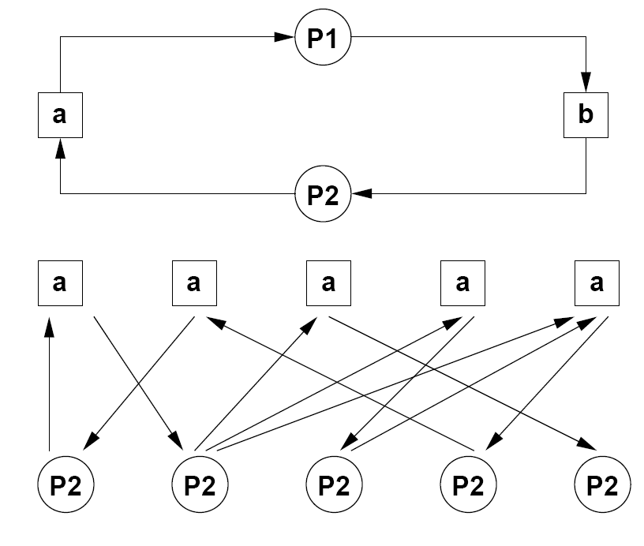
More Problems
Cycles in a resource allocation graph:
a
b
c
d
e
1
2
3
4
5
8
Swansea University
Benjamin Mora
Notes:
A should be renamed a,b,c,d,e, p2 => p1 to p5

Slide 9
Deadlock : Conditions
4 Conditions are required to get a deadlock situation:
Mutual exclusion condition. Each resource is either currently assigned to exactly one process or available.
Hold and wait condition. A process which is holding resources granted at an earlier time can request additional resources.
9
Swansea University
Benjamin Mora
Notes:
Hold and wait: can be seen as a non-atomic request of all resources

Slide 10
Deadlock : Conditions
4 Conditions are required to get a deadlock situation:
No pre-emption condition. Once a resource has been granted, it can't be forcibly taken away from a process. Rather, it must be explicitly released by the holding process.
Circular wait condition. There must be a circular chain of two or more processes, each of which is waiting for a resource held by the next member of the chain.
10
Swansea University
Benjamin Mora

Slide 11
Dealing with Deadlocks
11
Swansea University
Benjamin Mora

Slide 12
Dealing with Deadlocks
Just ignore the problem altogether (Ostrich algorithm).
Not wished.
(Post) Detection and Recovery.
Prevention by negating one of the four necessary conditions.
Making sure it will never happen.
Dynamic avoidance with a careful resource allocation.
(Pre) Detection and avoidance
Ordering Resources.
Banker’s Algorithm.
12
Swansea University
Benjamin Mora

Slide 13
Detection and recovery
Method 1:
Periodically checking if there are any processes that have been blocked for more than a given period (timeout).
Process can be killed or pre-empted
Not wished most of the time.
Method 2:
Check the resource allocation graph for possible cycles every time a resource is requested.
13
Swansea University
Benjamin Mora

Slide 14
Deadlock Prevention
Denying any of the 4 conditions:
Denying the Mutual Exclusion Condition.
No way.
Denying the hold and wait condition.
Each process must request all of its required resources at once
All or Nothing.
A process might not know what it will need at the start.
E.g., Memory.
Could cause serious waste of resources and indefinite postponement.
14
Swansea University
Benjamin Mora

Slide 15
Deadlock Prevention
Denying the no pre-emption condition:
When a process is refused a resource, release all the resources held
Some resources cannot be pre-empted (e.g., printer has already started printing).
Indefinite postponement possible depending on allocation patterns.
Denying the circular wait condition
Only using a single resource at a time.
Ordering resources.
15
Swansea University
Benjamin Mora

Slide 16
Deadlock Prevention
(Total) Ordering of Resources.
Order must be
established first on resources.
Processes must request
Resources in order.
R₁
P₁
P₂
R₂
P₁
R₃
P₂
R₄
P₁
R₅
16
Swansea University
Benjamin Mora

Slide 17
Deadlock avoidance
Allows the first 3 necessary conditions, but ensure that a deadlock will never be reached
Dynamic approach.
Alternatives must possibly be implemented.
Banker’s Algorithm
By Dijkstra.
Resource allocation state concept
Resources currently allocated per process.
Maximum number of resources possibly required per process.
Number of resources currently available.
17
Swansea University
Benjamin Mora

Slide 18
Deadlock avoidance: Banker’s Algorithm
Allocation of resources changes the resource allocation state.
The state is safe if we can ensure that all processes will finish.
Unsafe otherwise
Deadlock may occur.
Resources are allocated only if the new state is safe.
18
Swansea University
Benjamin Mora

Slide 19
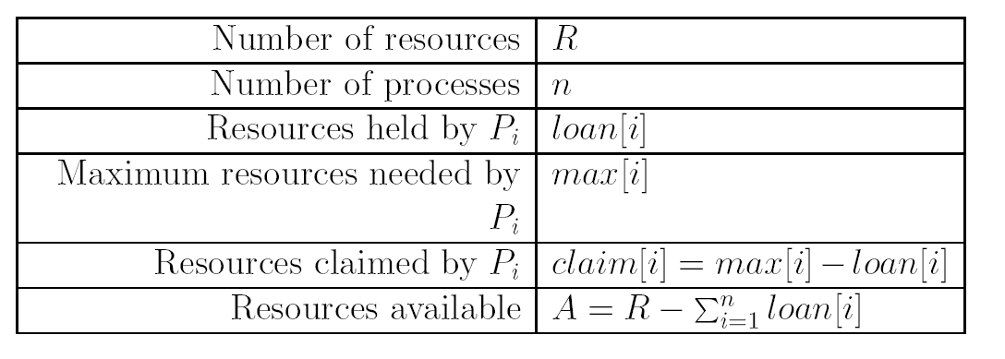
Deadlock avoidance: Banker’s Algorithm
Single type case:
A simple algorithm would be to test that for all running processes:
>=0
Inefficient.
19
Swansea University
Benjamin Mora

Slide 20
Deadlock avoidance: Banker’s Algorithm
Example 1: Safe case.
Loan
Max
Claim
P1
1
4
3
P2
4
6
2
P3
5
8
3
Resources
12
Available
2
20
Swansea University
Benjamin Mora

Slide 21
Deadlock avoidance: Banker’s Algorithm
Example 1: Safe case.
Loan
Max
Max Claimed
P1
1
4
3
P2
4
6
2
P3
5
8
3
Resources
12
Available
2
21
Swansea University
Benjamin Mora

Slide 22
Deadlock avoidance: Banker’s Algorithm
Example 1: Safe case.
Loan
Max
Max Claimed
P1
1
4
3
P2
0
0
0
P3
5
8
3
Resources
12
Available
6
22
Swansea University
Benjamin Mora

Slide 23
Deadlock avoidance: Banker’s Algorithm
Example 1: Safe case.
Loan
Max
Max Claimed
P1
1
4
3
P2
0
0
0
P3
5
8
3
Resources
12
Available
6
23
Swansea University
Benjamin Mora

Slide 24
Deadlock avoidance: Banker’s Algorithm
Example 1: Safe case.
Loan
Max
Max Claimed
P1
1
4
3
P2
0
0
0
P3
0
0
0
Resources
12
Available
11
24
Swansea University
Benjamin Mora

Slide 25
Deadlock avoidance: Banker’s Algorithm
Example 1: Safe case.
Loan
Max
Max Claimed
P1
0
0
0
P2
0
0
0
P3
0
0
0
Resources
12
Available
12
25
Swansea University
Benjamin Mora

Slide 26
Deadlock avoidance: Banker’s Algorithm
Example 2: Unsafe case.
Loan
Max
Max Claimed
P1
2
4
2
P2
4
6
2
P3
5
8
3
Resources
12
Available
1
26
Swansea University
Benjamin Mora

Slide 27
Deadlock avoidance: Banker’s Algorithm
Look for a process P_{i} whose unmet resource needs are less than or equal to A. If no such process exists, the system will eventually deadlock since no process can possibly complete.
Assume P_{i} requests all the resources it needs and finishes. Mark it as terminated and add all its resources to A.
Repeat steps 1 and 2 until either all processes are marked terminated, in which case the initial state was safe, or until a deadlock occurs, in which case it was not.
27
Swansea University
Benjamin Mora

Slide 28
Multiple Resources
Example 3: Multiple resource types (safe).
Max Resources
Loan
R1
R2
R3
R1
R2
R3
P1
3
2
2
1
0
0
P2
6
1
3
6
1
2
P3
3
1
4
2
1
1
P4
4
2
2
0
0
2
Resources
Available Resources
R1
R2
R3
R1
R2
R3
9
3
6
0
1
1
28
Swansea University
Benjamin Mora

Slide 29
Multiple Resources
Example 3: Multiple resources (safe).
Max Resources
Loan
R1
R2
R3
R1
R2
R3
P1
3
2
2
1
0
0
P2
6
1
3
6
1
2
P3
3
1
4
2
1
1
P3
4
2
2
0
0
2
Resources
Available Resources
R1
R2
R3
R1
R2
R3
9
3
6
0
1
1
29
Swansea University
Benjamin Mora

Slide 30
Multiple Resources
Example 3: Multiple resources (safe).
Max Resources
Loan
R1
R2
R3
R1
R2
R3
P1
3
2
2
1
0
0
P2
0
0
0
0
0
0
P3
3
1
4
2
1
1
P3
4
2
2
0
0
2
Resources
Available Resources
R1
R2
R3
R1
R2
R3
9
3
6
6
2
3
30
Swansea University
Benjamin Mora

Slide 31
Multiple Resources
Example 3: Multiple resources (safe).
Max Resources
Loan
R1
R2
R3
R1
R2
R3
P1
3
2
2
1
0
0
P2
0
0
0
0
0
0
P3
3
1
4
2
1
1
P3
4
2
2
0
0
2
Resources
Available Resources
R1
R2
R3
R1
R2
R3
9
3
6
6
2
3
31
Swansea University
Benjamin Mora

Slide 32
Multiple Resources
Example 3: Multiple resources (safe).
Max Resources
Loan
R1
R2
R3
R1
R2
R3
P1
0
0
0
0
0
0
P2
0
0
0
0
0
0
P3
3
1
4
2
1
1
P3
4
2
2
0
0
2
Resources
Available Resources
R1
R2
R3
R1
R2
R3
9
3
6
7
2
3
32
Swansea University
Benjamin Mora

Slide 33
Multiple Resources
Example 3: Multiple resources (safe).
Max Resources
Loan
R1
R2
R3
R1
R2
R3
P1
0
0
0
0
0
0
P2
0
0
0
0
0
0
P3
3
1
4
2
1
1
P3
4
2
2
0
0
2
Resources
Available Resources
R1
R2
R3
R1
R2
R3
9
3
6
7
2
3
33
Swansea University
Benjamin Mora

Slide 34
Multiple Resources
Example 3: Multiple resources (safe).
Max Resources
Loan
R1
R2
R3
R1
R2
R3
P1
0
0
0
0
0
0
P2
0
0
0
0
0
0
P3
0
0
0
0
0
0
P3
4
2
2
0
0
2
Resources
Available Resources
R1
R2
R3
R1
R2
R3
9
3
6
9
3
4
34
Swansea University
Benjamin Mora

Slide 35
Issues with the Banker algorithm
Processes rarely know in advance what resources they will exactly need
Need to quantify Max. resources.
The algorithm assumes that the number of instances of a particular resource does not vary. In practice, it might.
The algorithm assumes that the number of processes competing for the resources does not vary. In practice it will.
Some processes may be created later on.
The algorithm assumes that the processes may be scheduled independently of each other. In practice, processes often need to be synchronized.
35
Swansea University
Benjamin Mora

Slide 36
Other technical issues
Suspended processes.
What to do with the resource?
Overhead in code.
Complexity when having hundreds of processes or resources?
Algorithmic Complexity may not scale linearly…
Best Algorithms may be dependent on resources.
Group resources into classes and use a specific deadlock algorithm for each class.
36
Swansea University
Benjamin Mora

Slide 37
Starvation
The scheduling of a process is postponed indefinitely.
Called indefinite postponement as well.
All the other processes get the attention.
May occur because the system is biased
E.g., process priorities.
No insurance that the process will finally go through.
Reliability.
Can be easily detected by the OS, which can then grant access to resources.
37
Swansea University
Benjamin Mora

Slide 38
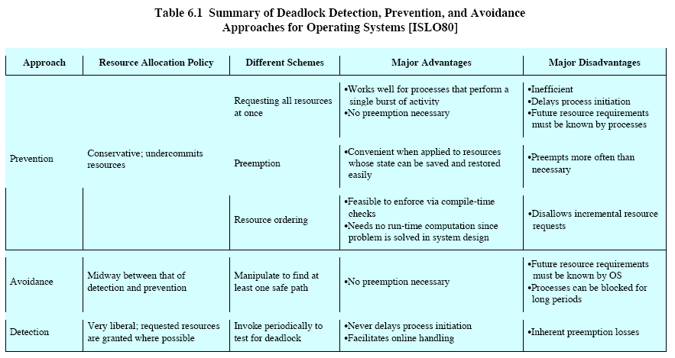
Summary
38
Swansea University
Benjamin Mora

Slide 39
Mutexes in C++11 – A few examples
Class std::mutex
lock(). //Only one thread object at a time can get the lock. Other threads block until lock becomes available again.
unlock(). //Release the lock
try_lock(). //Try to get the lock and returns whether acquiring the lock has been successful or not. Does not block in case the request fails so one can try later.
Locking several objects at once is possible, preventing deadlocks
E.g., std::try_lock(m1,m2).
class recursive_mutex
The mutex is re-entrant. The thread locking a recursive mutex already locked will not block on another lock event.
39
Swansea University
Benjamin Mora

